Slide 1
Praise Assembly
22/04/2021

Slide 2
Thank you for working so hard, your teachers are really proud of you…….

Slide 3
Reception Super Stars…..
REB-
Anthony Brown for using the play dough
to work out subtractions
RSR-
Joseph Byrne for trying his best on Lexia, and moving on to a new level
RSR-
Lilly O'Donnell for putting lots of effort into her independent writing, writing lots of sentences this week.

Slide 4
Year 1 Super Stars
Y1GA-
Ava Doherty for joining in and being more confident in phonics lessons
Y1 Mrs Gilliland- Faith Swords for putting in 100 % effort her work and becoming more confident in English and phonics

Slide 5
Year 2 Super Stars…..
Y2CY- Isla M for working hard in all lessons this week
Y2MB- Lee Cooper for working hard in all lessons and writing some fantastic, descriptive sentences in English

Slide 6
PE Super Stars this week…..
Jamie Barry-
For fantastic effort
and attitude In PE
Annie McNally-
For a great start
Developing her bowling skills in cricket

Slide 7
Music & ICT Super Stars
Music
Emmanuel Y2 for brilliant singing
ICT
Emily I Y1 for brilliant computer art

Slide 10
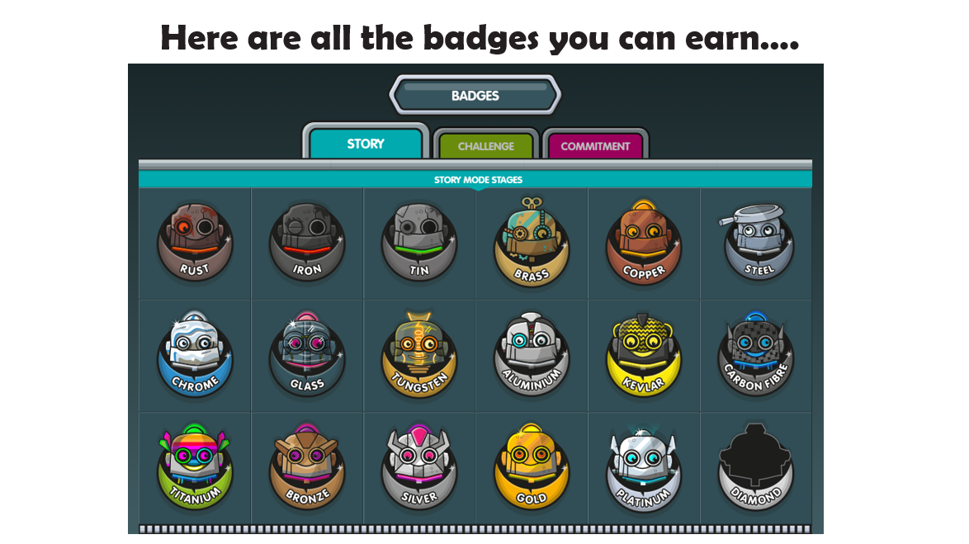

Slide 12
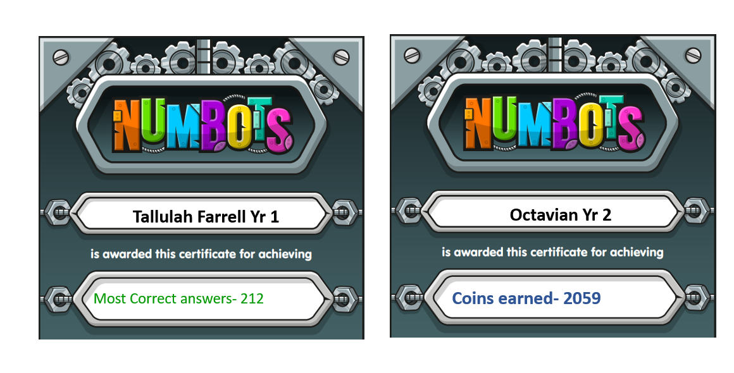

Slide 13
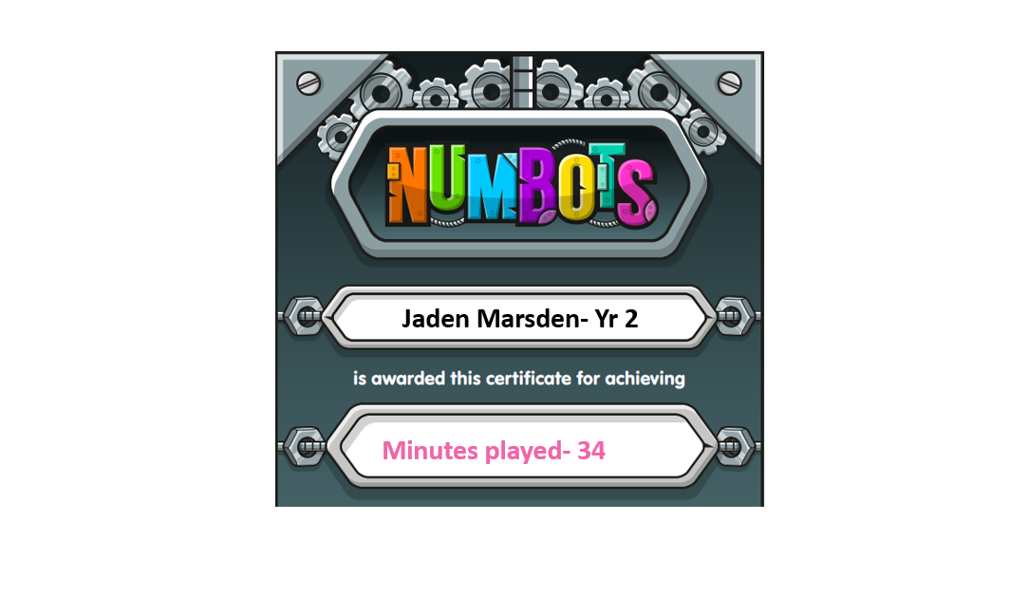
Jayden MacMullen

Slide 14
Year 3 Super Stars this week are…..
Y3CS-
Ayauri Showers For settling in to the class so well
Y3RT-
Blake Morton for fantastic work in English.
Y3CS-
Aiden for being a kind friend and helping other children when they need help
Y3CS-
Jayden Allen for fantastic description work

Slide 15
Year 4 Super stars this week are …….
Y4EB
Charlotte English for a mature attitude to work
4CL-
Isla Langstaff and Macy Baker for being shining examples to others and working hard at all times

Slide 16
Year 5 Super Stars……
Y5JPB-
Edward Farrell for using powerful & ambitious vocabulary in his writing
Y5RB-
Abbie Roberts for great effort during our maths lessons on multiples and factors and always engaging and answering questions during lessons
Y5JPB-
Harley Knowles for using similes in his writing

Slide 17
Year 6 Super Stars this week are…..
Y6KJ-
Aidan Aldridge for always being enthusiastic and willing to join in class discussions

Slide 18
Class of the Week…..
This week our class of the week goes to Y6KJ, well done Y6KJ you have really impressed your teacher this week. Miss Jones says you have been amazing role models for our school this week especially when walking to and from the swimming baths.

Slide 19
Music & ICT Super Stars
Music
Aiden D Y3 for brilliant enthusiasm in singing
Layla D Y6 for being really helpful in ukulele
ICT
Rosie O Y3 for brilliant pointillism computer art
Rhea M Y5 for brilliant effort and research skills

Slide 20
PE Super Stars this week…..
Lilli Rose – for her all-round skills in P.E. she is very impressive
Mirabel Ohimia – For showing a good understanding of the cricket game and rules; her ability to able to help others also
Ciaran Wallace - Great coordination and accuracy when batting in cricket
Miracle Ohimia - Massive boost in confidence and demonstrating skills for the class to follow

